Slide 1
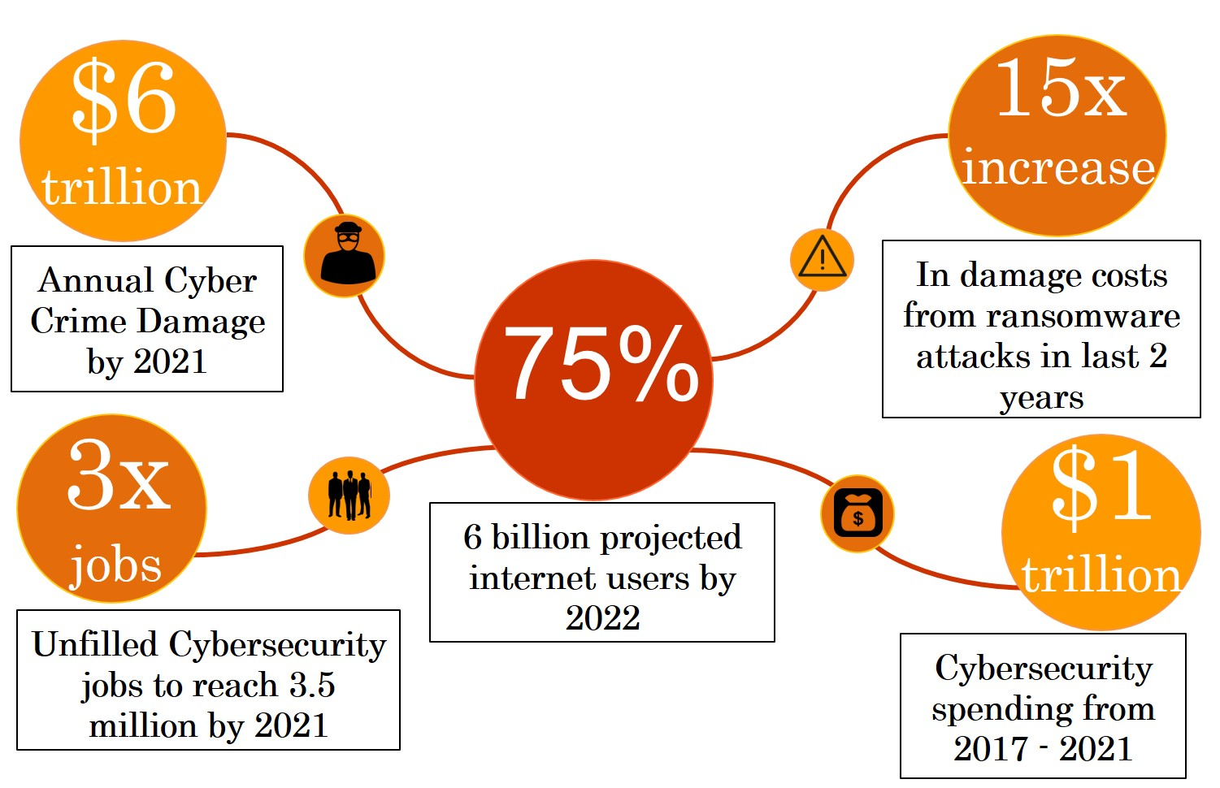
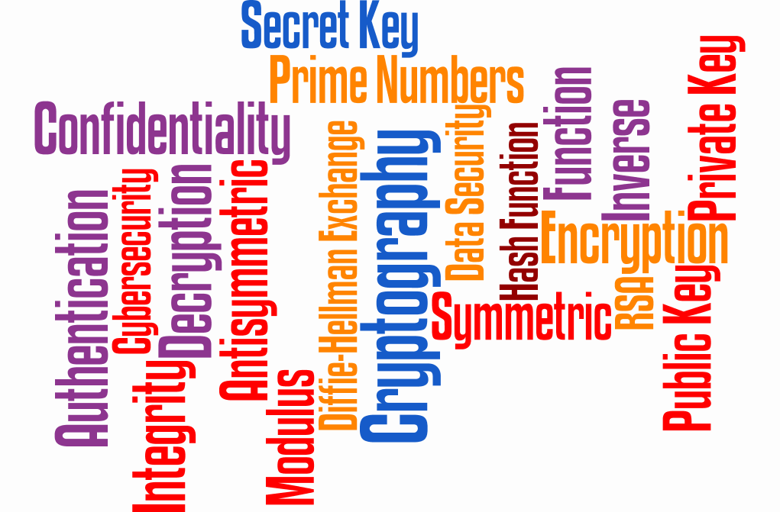
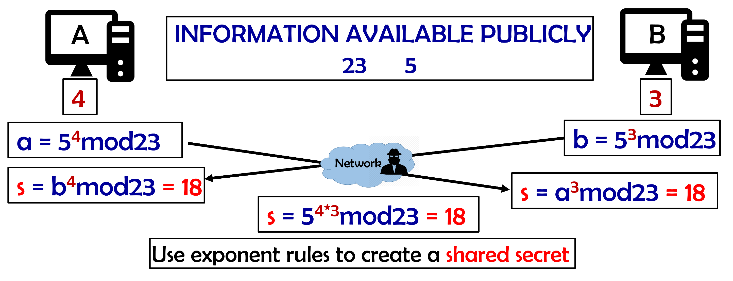
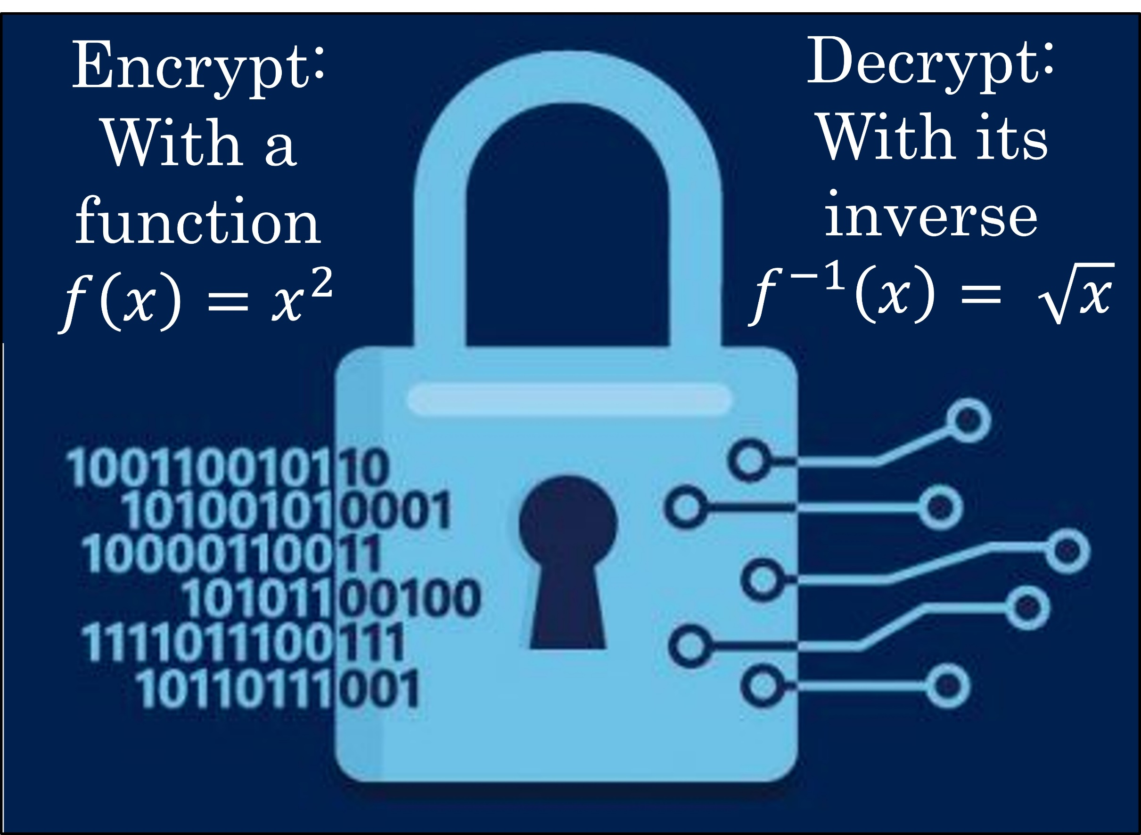
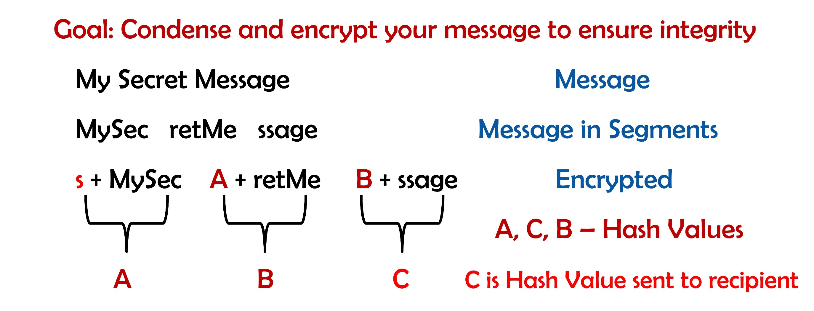
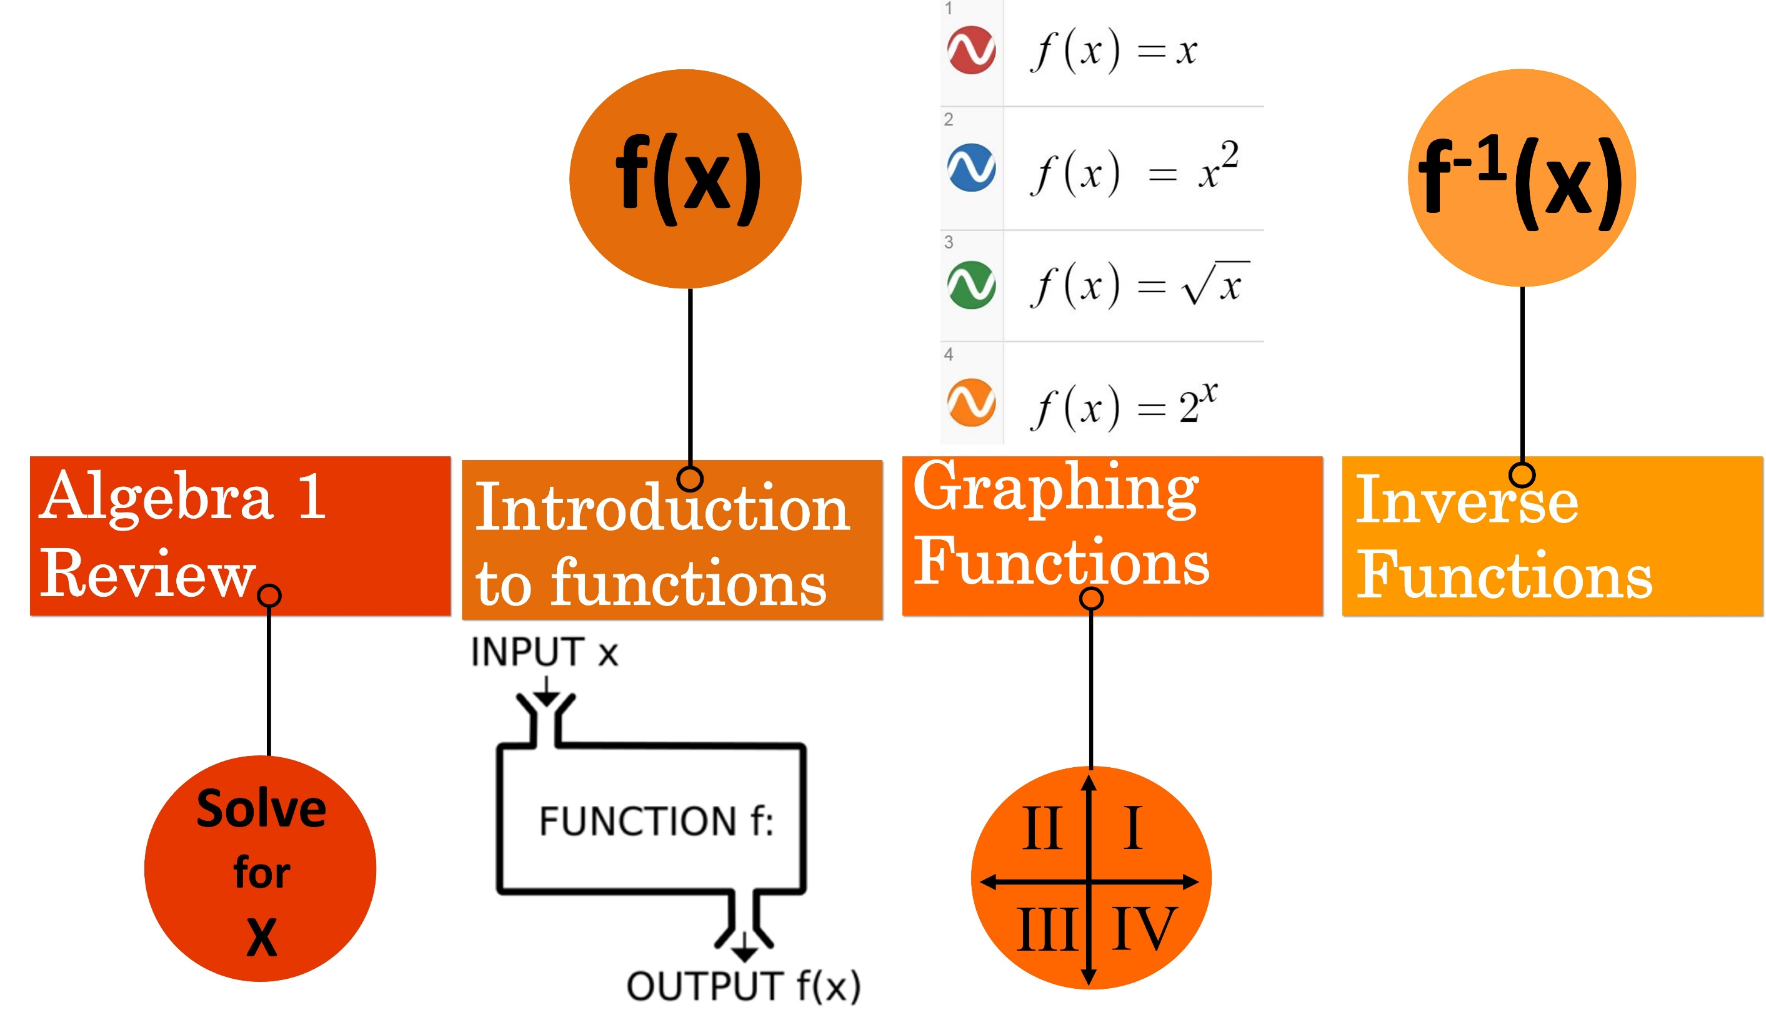
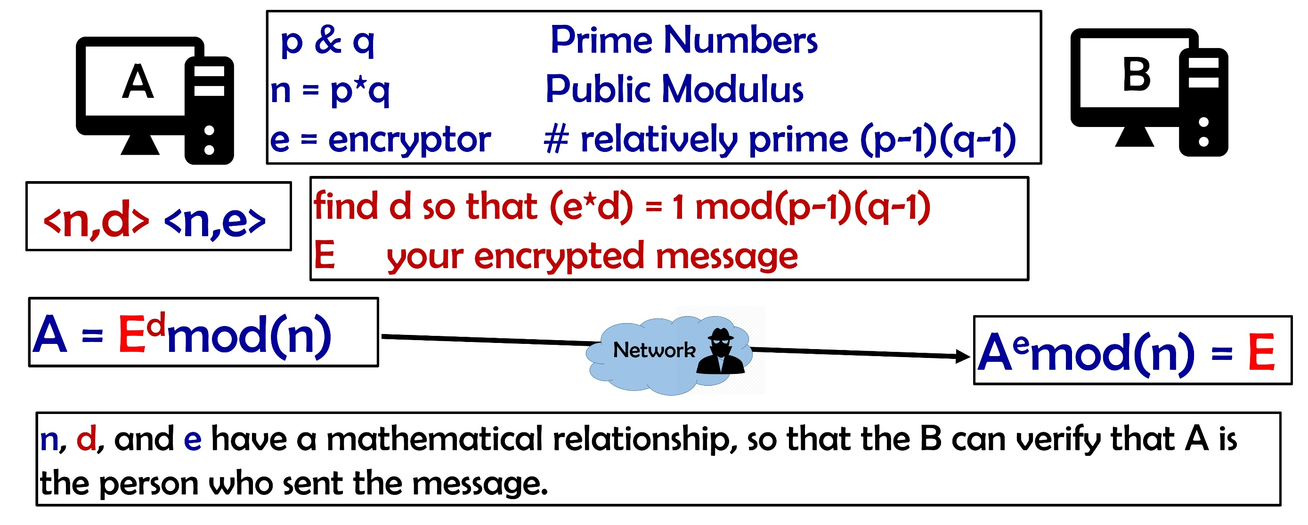
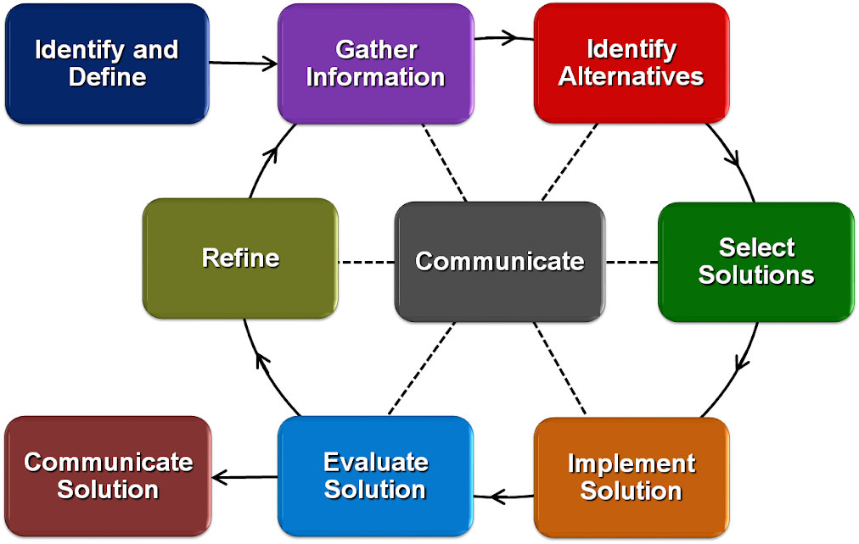
Cybersecurity and Data Encryption
Kelly Hiersche
Middlesboro High School | Algebra II | 10-11
RET is funded by
the National Science Foundation, grant
# EEC-1710826
Summer Study
Security Significance
Student Scholarship
Encryption – Ensuring data security from infiltrators
Confidentiality – Encryption through shared, secret key; Diffie-Hellman Exchange
Integrity – Ensure a message has not changed as it traveled; Hash functions
Authentication – Confirm a message came from the intended sender; RSA
Why is Cybersecurity an important field?
How do we relate cybersecurity to Algebra II?
When will we be ready to cover this topic?
Define – Cryptography terms & concepts
Understand – What makes an encryption method effective?
Efficient for good guys to compute – computationally difficult for infiltrators to reverse
Today – How is math used to encrypt information?
Method – Engineering Design Process
“If lots of smart people have failed to solve a problem, then it probably won’t be solved (soon).” - Kaufman

